Slide 1
2020 – ‘A YEAR TO REMEMBER’
A DESPERATE, POWERPOINT-HEAVY STAB AT FINDING SOMETHING POSITIVE / MILDLY HUMOROUS TO TALK ABOUT FOR TEN MINUTES FROM THIS ABSOLUTE CAR CRASH OF A YEAR

Slide 2
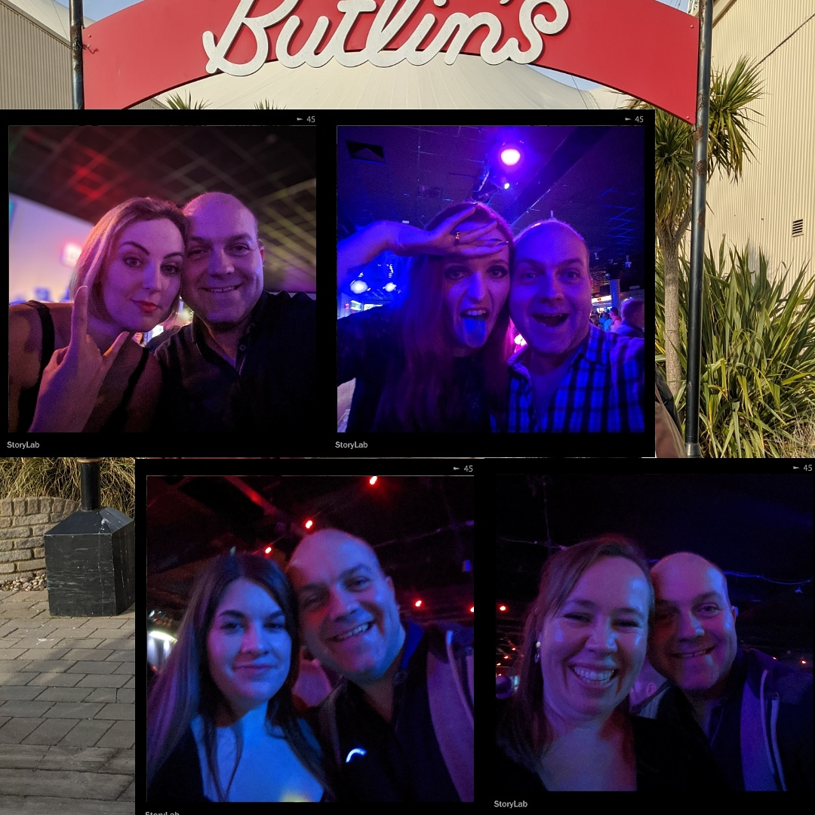
IT ALL STARTED SO WELL…
NEW YEAR’S EVE FIREWORKS WERE QUITE NICE
I HAD A NICE TIME AT BUTLIN’S
I SAW ANDY & THE ODD SOCKS PERFORM LIVE ON STAGE
UM, THERE WERE SOME GOOD SHOWS ON TV
I LOST A FEW LBS…

Slide 3
IT DIDN’T LAST LONG
BUSHFIRES RAVAGED AUSTRALIA
TRUMP ACQUITTED
UKRANIAN FLIGHT CRASHES IN TEHRAN
UK WITHDRAWS FROM EU – KIND OF…
OLYMPICS POSTPONED
OH, AND A THE ENTIRE WORLD FELL APART BECAUSE OF BLOODY COVID-19
BUT IT WASN’T ALL BAD…

Slide 4
PETROL WAS, LIKE, SUPER-CHEAP
YES, THERE WAS NOWHERE YOU COULD ACTUALLY GO TO IN YOUR CAR, BUT IF YOU DECIDED TO TAKE A BREAK FROM THE BOREDOM OF LOCKDOWN LIFE BY TESTING YOUR HEALTH AND YOUR EYESITE BY POPPING TO A SCENIC SPOT SOMEWHERE IN THE NORTH OF ENGLAND YOU COULD DO SO WITHOUT BREAKING THE BANK – WINNER!

Slide 5
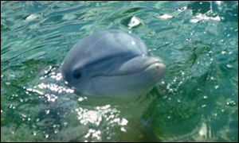
THE ENVIRONMENT THRIVED
THE ICE CAPS STOPPED MELTING
DOLPHINS ONCE AGAIN SWAM IN THE THAMES
17 NEW SPECIES OF BADGER WERE DISCOVERED
I SPOTTED A DODO & A BABY T-REX PLAYING IN OUR GARDEN
WE ALL GOT TO PRACTICE BEING GREEN BY WIPING OUR ARSES WITH OUR BARE HANDS BECAUSE SOME MASSIVE BELLEND HAD BOUGHT ENOUGH TOILET ROLL TO MUMMIFY THE ENTIRE GLOBE

Slide 6
HOMESCHOOLING
NO SCHOOL RUN – EXTRA FEW MINUTES IN BED
NO EMAILS FROM THE SCHOOL ABOUT PEOPLE PARKING INCONSIDERATELY
NO NITS
LIFELONG MEMORIES – THAT MAY ONLY BE ERASED BY YEARS OF THERAPY
PRACTICING LIFE SKILLS – PATIENCE, RESILIENCE, NEGOTIATION, NOT LOSING YOUR SHIT IN THE FACE OF EXTREME PROVOCATION
GREAT TO FINALLY USE THE PRINTER YOU BOUGHT 4 YEARS AGO
A SPECIAL APPRECIATION OF YOUR CHILD’S ACTUAL TEACHERS
DAY-DRINKING BECAME SOCIALLY ACCEPTABLE

Slide 7
‘WORKING FROM HOME’
GREAT OPPORTUNITY TO SPEND QUALITY TIME AT HOME WITH THE FAMILY – FOR FIVE SOLID, SEEMINGLY-UNENDING MONTHS
THE FUN OF CONFERENCE CALLS INTERSPERSED WITH SCREAMING KIDS & DEMANDS TO WIPE BUMS – OH HOW WE LAUGHED!
FINDING INNER PEACE AFTER RUNNING OUT OF ANYTHING TO SAY TO EACH OTHER AFTER WEEK 2
ONLY HAVING TO WIPE YOUR CHILD’S PISS FROM THE TOILET SEAT BEFORE SITTING DOWN RATHER THAN YOUR COLLEAGUES’ PISS
DISCOVERING YOUR PARTNER USES COOL WORDS LIKE ‘IDEAS SHOWER’, ‘TOUCH BASE’, ‘SOLUTIONISE’ & ‘GOAT RODEO’ ON WORK CALLS

Slide 8
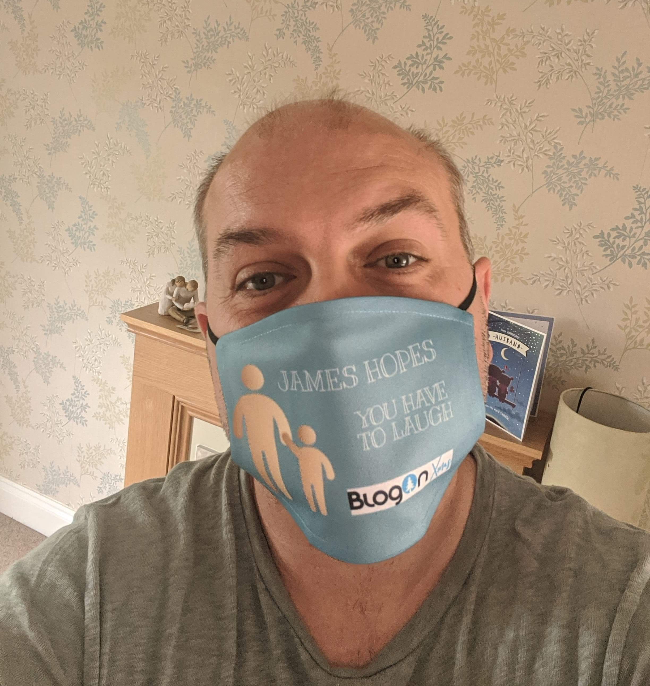
CAN YOU SEE ME NOW?!
CAN INSULT PEOPLE WITHOUT THEM KNOWING
NO NEED TO APPLY LIPSTICK OR BRUSH TEETH
CAN GO STRAIGHT FROM THE SHOPS TO A MASQUERADE BALL WITH 5 OF YOUR FRIENDS WITHOUT NEEDING TO CHANGE
CAN DISGUISE YOURSELF AS SOMEONE ELSE AND COMMIT CRIMES
CAN JOIN A TEAM OF MASKED SUPERHEROES AND CLEAR THE STREET OF EVIL VILLAINS

Slide 9
THE JOY OF ZOOM
LEARNING TO EMBRACE BINGO & QUIZZES AS THE SOLE FORM OF ENTERTAINMENT FOR 5 MONTHS
GETTING TO HAVE A NOSE AT YOUR FRIENDS’ HOUSES & QUIETLY JUDGE THEM FOR THEIR ‘LIVE, LOVE, LAUGH’ WALL ART
GETTING TO MEET YOUR FRIENDS’ OTHER HALVES – SOMETIMES HALF-NAKED WANDERING ACROSS THE BACK OF THE SHOT
DEMONSTRATING YOUR AMAZING WIT & INTELLIGENCE WHILST PLAYING A VARIETY OF JACKPOT GAMES – BEING CROWNED QUIPLASH KING…
SEEING SOME OF YOUR FRIENDS A LOT MORE THAN YOU NORMALLY WOULD OUTSIDE OF LOCKDOWN & REALISING THAT YOU REALLY SHOULD MEET UP WITH THEM MORE OFTEN

Slide 10
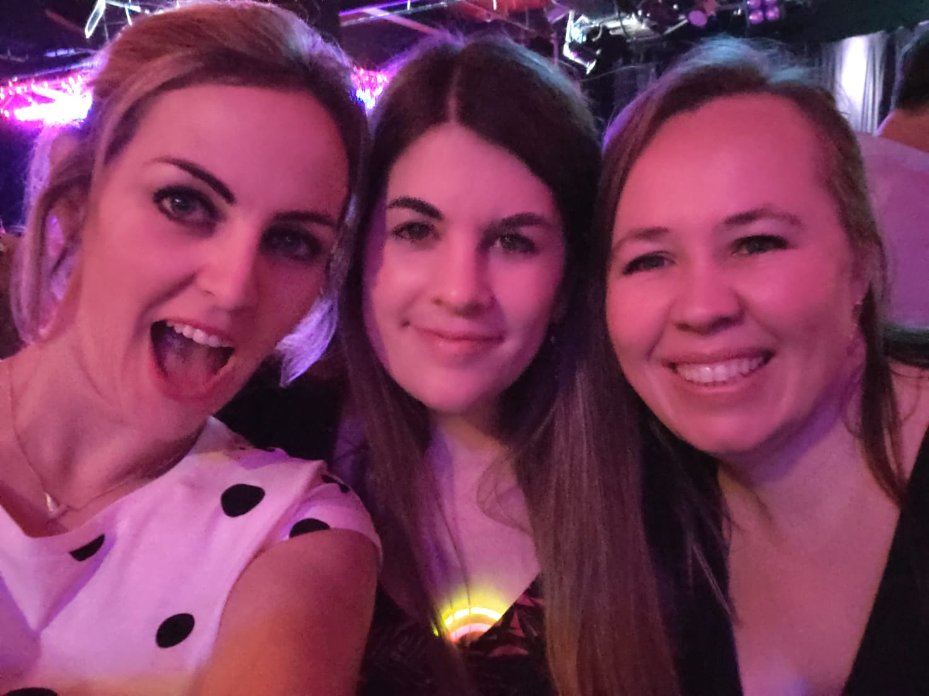
COUNTING THE PENNIES
MASSIVE SAVINGS ON LUNCHES BOUGHT AT WORK – ALBEIT OFFSET BY THE SHIT-TONNE OF CHOCOLATE & ALCOHOL BOUGHT INSTEAD
NO NEED FOR PESKY, EXPENSIVE MEALS & NIGHTS OUT WITH FRIENDS
NO NEED TO BLOW CASH ON SWANKY ALL-INCLUSIVE FOREIGN HOLIDAYS SPENT SITTING BY THE POOL & SIPPING COCKTAILS
WHO NEEDS STUFF TO LOOK FORWARD TO?
NOT ME!
THAT’S FOR SURE…

Slide 11
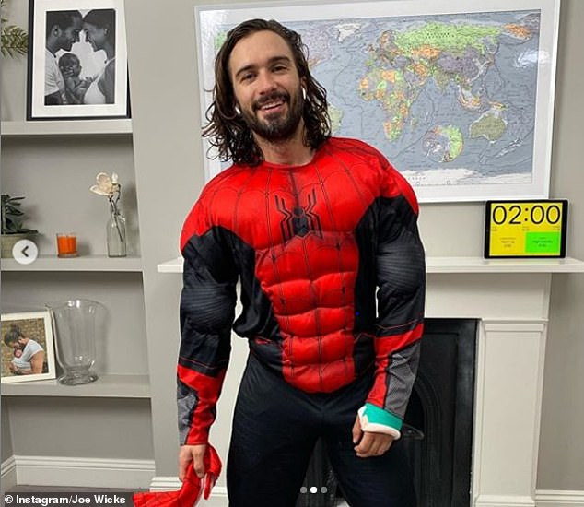
LEARNING NEW SKILLS
BECOMING A FULLY CAPABLE, SUPER-EFFECTIVE TEACHER…
HOW TO EAT CHEESE FOR AT LEAST TWO MEALS PER DAY
HOW TO PUT ON WEIGHT DESPITE THERE BEING BUGGER ALL IN THE SHOPS
HOW TO GET FIT WITH JOE WICKS AND WORK ON THAT SIX PACK – UNTIL YOU GOT ANNOYED BY HIS VOICE, YOUR LEGS HURT TOO MUCH BECAUSE OF THE STUPID SPIDERMAN LUNGES AND YOU GENERALLY COULDN’T BE ARSED TO DO IT ANYMORE

Slide 12
REDUCED DOOR KNOCKERS
NO DISCUSSIONS ABOUT JESUS
NO OFFERS TO TARMAC MY DRIVE OR TRIM MY BUSHES
NO GUILT TRIPS TO DONATE TO DONKEYS IN DANGER, OR PIGEONS IN PERIL OR TO REINTEGRATE BAR-FIGHTING BADGERS
NO FAILED DELIVERIES – BECAUSE YOU’RE ALWAYS HOME!
NO FRIENDS OR FAMILY OR ANYONE ELSE FOR THAT MATTER

Slide 13
READY-MADE EXCUSES TO AVOID STUFF YOU HATE
SORRY SON, SOFT PLAY IS CLOSED
NO YOU CAN’T COME SHOPPING WITH ME BECAUSE OF THE BUG
GYM – CLOSED
KIDS BIRTHDAY PARTY – CANCELLED
BORING WORK MEETING – VIA ZOOM
WORK SOCIALS – NAH MATE – IT’S THE BUG INNIT
GET ON THE TUBE / BUS – NO POINT
EVERYTHING.
IS.
CLOSED.

Slide 14
TABLE SERVICE AT NANDO’S & PUBS
NO STANDING IN QUEUES WITH SMELLY STRANGERS
NO NEED TO GET YOUR OWN PLATES / DRINKS / FOOD
CAN’T LEAVE TIP BECAUSE CASH CARRIES GERMS & STUFF
NO ONE CLOSE ENOUGH TO LISTEN IN ON YOUR CONVERSATION
CAN MORE EASILY INSULT PEOPLE ON NEARBY TABLES WITHOUT THEM HEARING YOU

Slide 15
BRAND NEW ON-TREND WORDS & PHRASES TO IMPRESS YOUR FRIENDS
SOCIAL DISTANCING
FURLOUGH
COMMON SENSE OF THE BRITISH PEOPLE
SECOND WAVE
SUPER-SPREADER
BARNARD CASTLE
SELF-ISOLATION
ABSOLUTE SH*TSHOW

Slide 16
EXCITING NEW SLOGANS

Slide 17
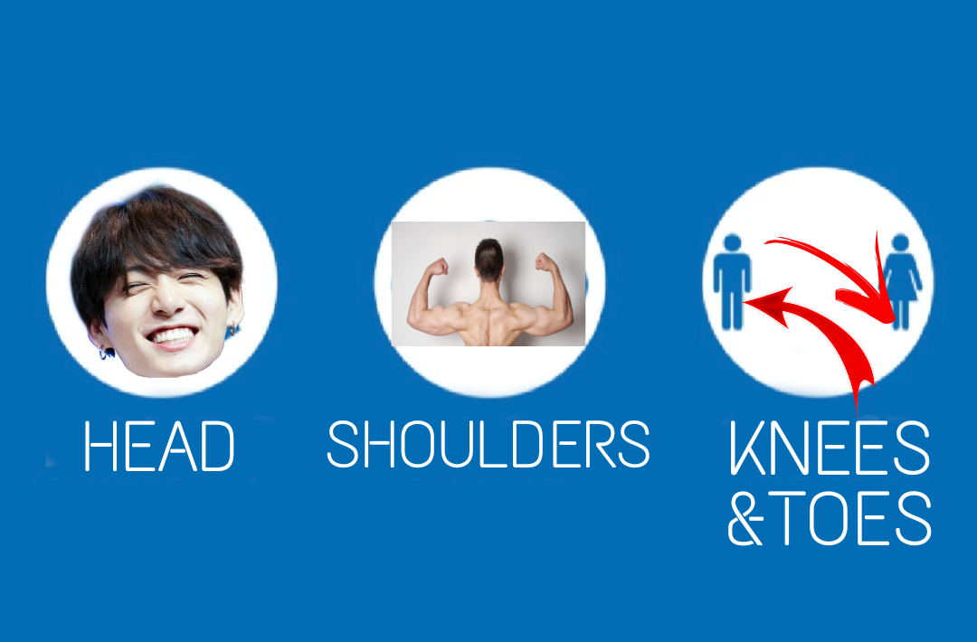
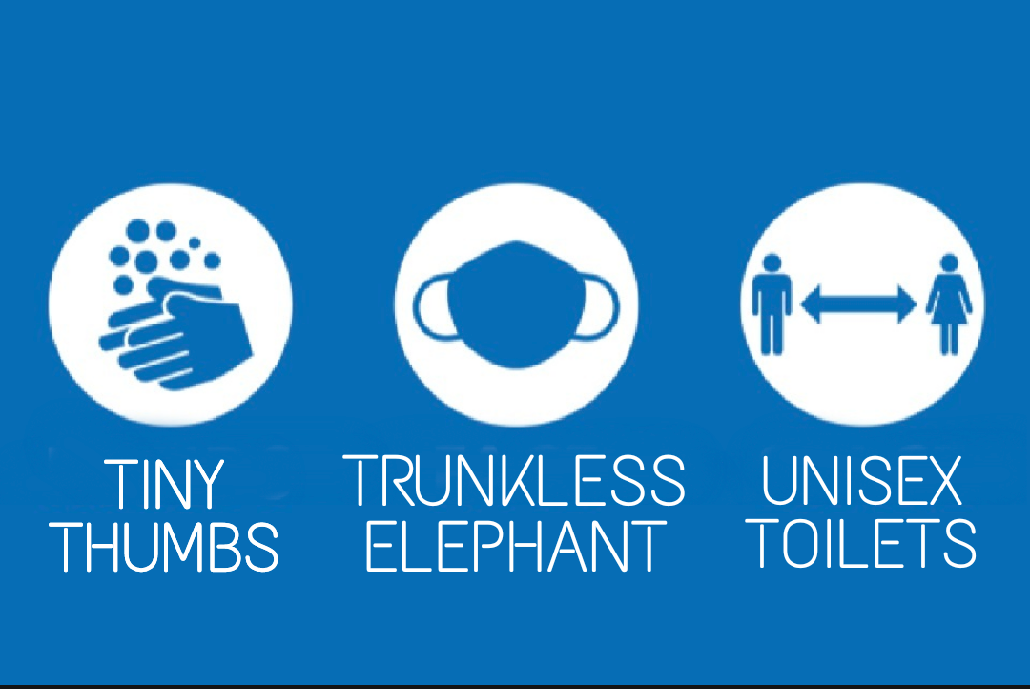
EXCITING NEW SLOGANS

Slide 18
BLOGON 2020 – BETTER TOGETHER APART

Slide 19
DRESS TO IMPRESS (OR DON’T BOTHER!)
NO NEED TO DRESS UP IN FANCY CLOTHES – OR ANY CLOTHES AT ALL IF IT’S BELOW THE WAIST / FRAME
IF YOU SPILL SOMETHING DOWN YOURSELF YOU CAN POP OFF AND CHANGE RATHER THAN SPENDING THE DAY WITH RED WINE DOWN YOU
IF YOU TURN UP IN THE SAME OUTFIT AS SOMEONE ELSE YOU CAN TRY ANOTHER OPTION – OR JUST BUMP THE OTHER PERSON OFF THE SCREEN AND PRETEND THEY DON’T EXIST

Slide 20
DO I KNOW YOU FROM SOMEWHERE?
NO NEED TO PRETEND YOU KNOW SOMEONE WHEN YOU SEE THEM – YOU CAN DISCREETLY RESEARCH THEM VIA SOCIAL MEDIA IN REAL TIME OFF CAMERA
NO NEED TO STARE AT PEOPLE’S LANYARDS TO FIND OUT WHO THEY ARE – ASSUMING THEY’VE UPDATED THEIR USERNAME ON ZOOM…
IF SOMEONE IS ANNOYING / BORING YOU, NO NEED TO SPEND MINUTES TRYING TO EXTRICATE YOURSELF – JUST FAKE A WIFI OUTAGE AND POP OFF INTO ANOTHER SESSION!

Slide 21
NO TOUCHY-FEELY STUFF
NO NEED FOR MUCKY STUFF LIKE HUGGING & KISSING FRIENDS
NO NEED TO MAKE NEW FRIENDS - JUST LEARN, LEARN, LEARN
NO DRUNKEN PEOPLE GETTING A BIT GRABBY ON THE DANCE FLOOR
NO MAKING POLITE CONVERSATION WITH STRANGERS QUEUING FOR THE TOILETS

Slide 22
CLUB TROPICANA – DRINKS ARE FREE
PAY FOR NOTHING – ALL FOOD AND DRINKS ARE FREE (AS LONG AS YOU’VE ALREADY BOUGHT THEM)
NO JUDGEY LOOKS IF YOU’RE NECKING SHOTS OR SIPPING A PORNSTAR MARTINI AT 10AM
NO FEELING GUILTY FOR TAKING 7 GLASSES OF PROSECCO & 9 SLICES OF PIZZA FROM ONE OF THE STANDS – AND THEN GOING BACK FOR MORE
NO NEED TO WORRY ABOUT STAGGERING HOME AFTERWARDS
NO NEED TO PAY FOR A MANKY TRAVELODGE THAT HAS NO BAR & DOESN’T SERVE BREAKFAST

Slide 23
OTHER MINOR BENEFITS
SCRATCH YOUR ARSE OR PICK YOUR NOSE WHENEVER YOU FANCY (JUST TURN OFF YOUR VIDEO)
ENJOY THE COMFORT OF YOUR OWN BED – BEFORE, DURING & AFTER
IF YOU GET BORED IN A SESSION, JUST NOD, SMILE, GO ON MUTE AND POP THE TV ON IN THE BACKGROUND
CAN’T BE BOTHERED TO TIDY THE HOUSE? – POP ON A FAKE BACKGROUND
NO NEED TO WEAR A MASK & NO ONE WILL STARE AT YOU IF YOU COUGH – AS LONG AS YOU’RE ON MUTE
BINGO & NAKED MEN – IF YOU LIKE THAT KIND OF THING…

Slide 24
DON’T PANIC IT’S THE FINAL SLIDE…
YOU CAN PICK & CHOOSE WHAT YOU WANT TO SEE & WATCH IT BACK LATER
CATCH UP ON ANYTHING YOU MISSED UNTIL THE END OF 2020!
MOST IMPORTANTLY, YOU CAN HAVE A LIE IN AND MISS THE LOW-BROW, BARELY AMUSING, HASTILY-COBBLED-TOGETHER-AT-1.30AM-ON-FRIDAY MORNING KEYNOTE SPEECH
UNLESS YOU’RE ACTUALLY HERE, IN WHICH CASE – THANKS & HAVE AN AWESOME DAY!

